Slide 1
Annual Interagency Accessibility Forum
Unlocking the Power of Accessibility
October 11-13, 2022
Intelligence Community Information Technology Accessibility Program Maturity Model
Office of the Director of National Intelligence (ODNI)

Slide 2


Introductions
Ms. Shannon Paschel, Information Technology (IT) Diversity, Equity, Inclusion and Accessibility Chief, ODNI
Dr. Rosemary Speers, Contractor Team Lead, Supporting IT Diversity, Equity, Inclusion and Accessibility, ODNI
Ms. Nancy Casper, IT Specialist, Office of the Chief Information Officer, FBI

Slide 3

Intelligence Community
The Director of National Intelligence (DNI) serves as the head of the IC.
The IC is a coalition of 18 agencies and organizations (IC Elements), including the Office of the DNI (ODNI)
From www.odni.gov

Slide 4

IC IT Accessibility Community of Interest (COI)
The IC IT Accessibility COI was established in 2018, under the IC CIO Council, to propose strategic recommendations for improving IT accessibility
Members of the COI include Section 508 program managers from IC Elements

Slide 5
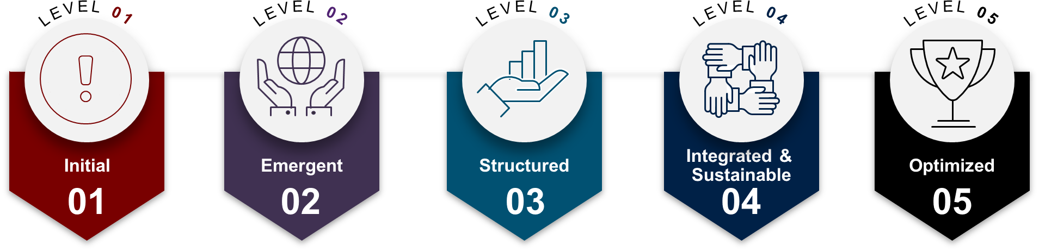
Maturity Levels 1-5
The IC IT Accessibility Program Maturity Model has five maturity levels:

Slide 6
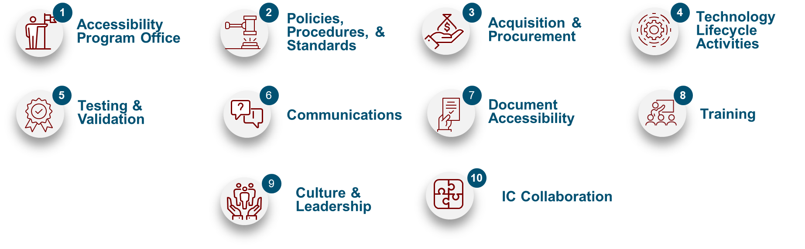
Core Dimensions
The maturity levels are assessed across ten core dimensions:

Slide 7
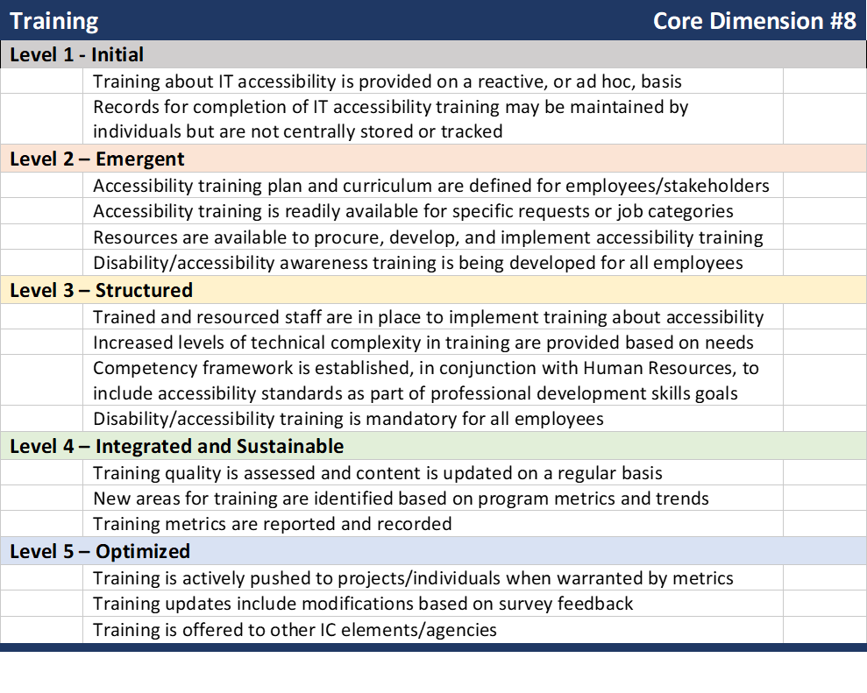
Example: maturity levels for a core dimension
The maturity model is detailed in a document that includes:
Overview
Descriptions of maturity levels and core dimensions
Tables with checklists for the core dimensions
List of acronyms and glossary with definitions of terms

Slide 8
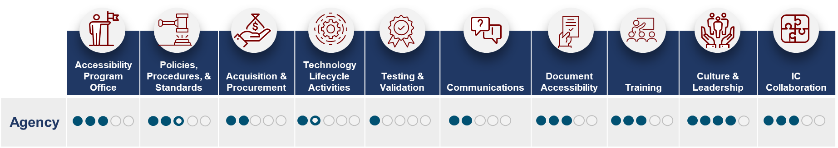
Scoring the maturity assessments
That COI decided that, in order to achieve a specific level of maturity, all of the items for that level must be completed
Later, the group used half-scores for partially completed levels
Notional scoring for an Agency:

Slide 9
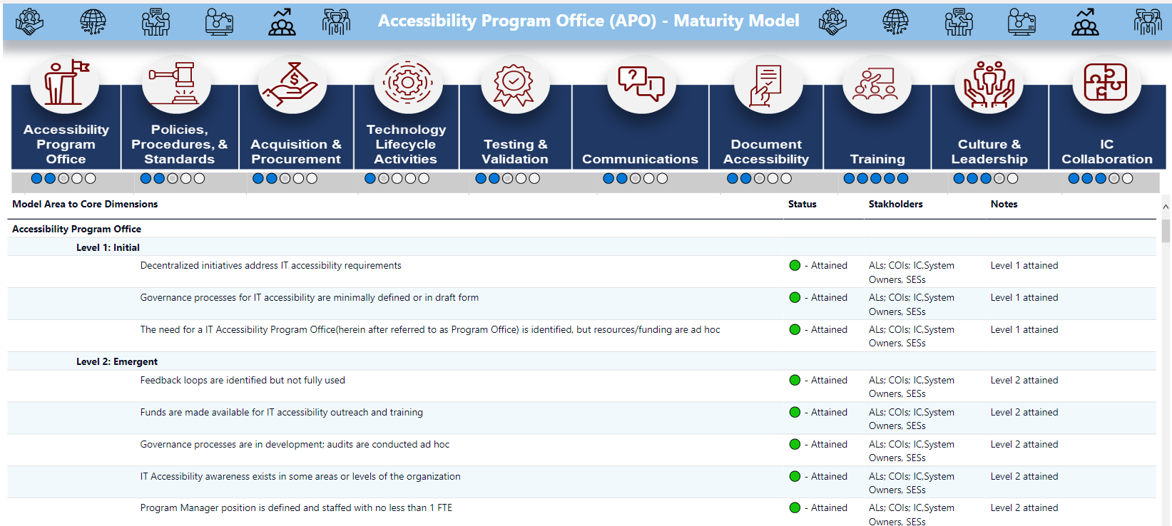
FBI Maturity Model

Slide 10
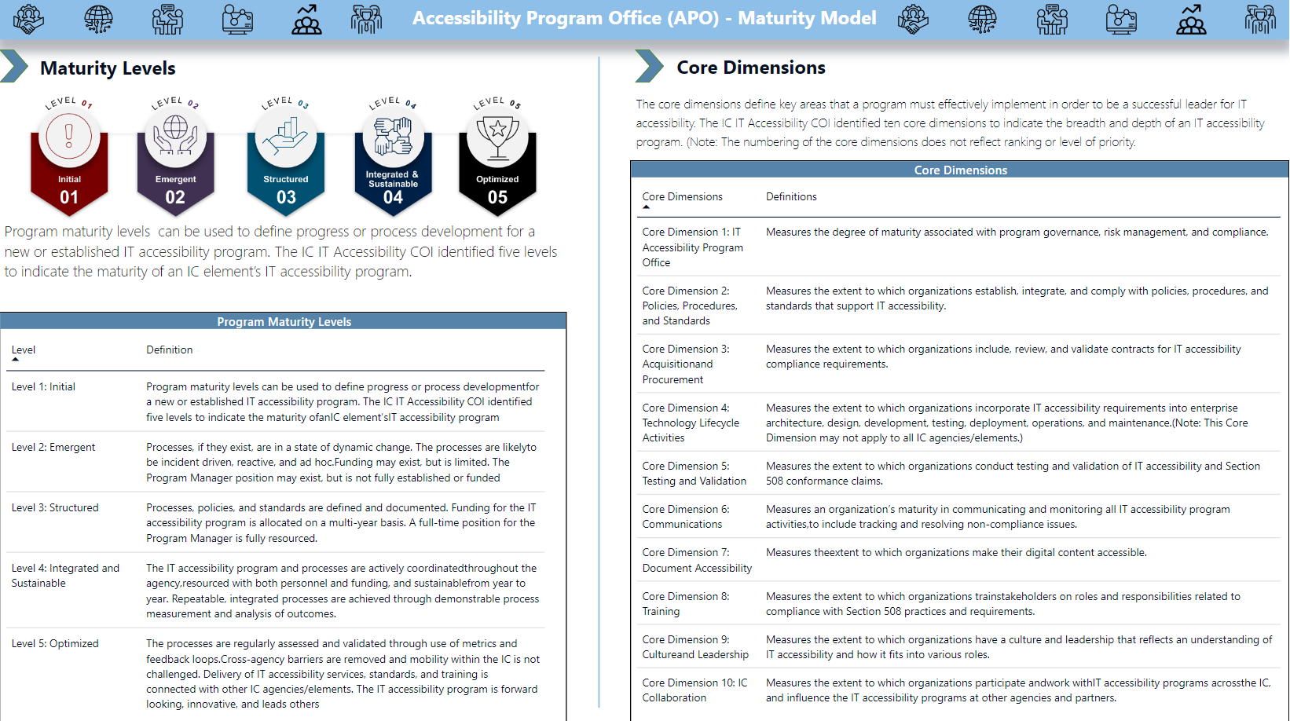
FBI IC Maturity Appendix

Slide 11


Questions?

